Slide 1



Kids Care
About Rare
Raising Awareness of
World Rare Disease Day
February 28th, 2025

Slide 2

Do you know Which month is the Busiest Month of the year?
While February is the shortest month of the year it is filled with SO many special days! There’s Groundhog’s Day, the 100th Day of School, President’s Day, Chinese New Year, and Valentine’s day. Also, February is Black History Month.

Slide 3

At the end of the month there is a VERY special day.
Rare Disease Day

Slide 4
What is Rare Disease Day?
Rare Disease day is celebrated on February 28th (February 29th in a leap year)
It is celebrated all over the WORLD.
It’s a day where we stop and think about all the kids who have rare genetic diseases.
It’s a day where we can CARE ABOUT RARE!

Slide 5



We open our hearts to think about kids who have rare genetic diseases.
What “Care About Rare” Means
There are over 7,000 rare diseases.
Most kids with a rare disease don’t have medicine or a treatment to help them feel better.

Slide 6

Who are Rare Kids?
Rare kids are kids just like YOU!
They love their family, pets, friends and community.
They attend school, enjoy events, listen to music, and watch shows.
They can be happy, sad, friendly, curious, frustrated, silly, scared, or joyful.
Rare kids are kids just like you!

Slide 7

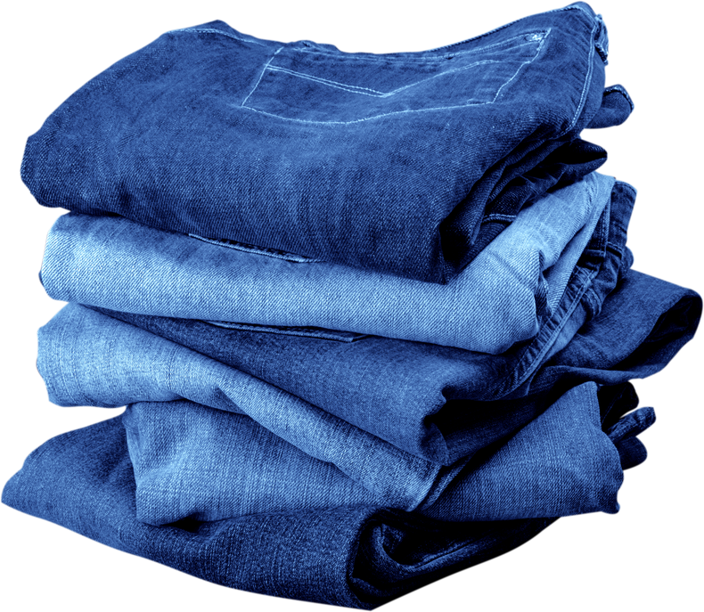

What Makes a Kid Rare?
Difference
in their
genes

Slide 8

What are Genes?
Genes are sort of like building blocks that make you, actually you!
Things your genes are responsible for are: your eye color, your hair color, if you will have freckles, whether or not your hair will be curly or straight
Genes can have little parts that are missing OR get mixed up and that’s what creates a rare genetic disease.
Think of building a lego kit with a part missing or the directions are mixed up. You can still make the creation but it might be a little different.

Slide 9


How to Care for Rare
Wear to Show you Care: People like to wear jeans or stripes on Rare Disease Day to show their support.
Share to Show you Care: Tell a family member, friend, or community member what you learned about Rare Disease Day.
Care about Rare to Show you Care: Treat all kids with love, kindness and empathy.

Slide 10
Thank you
For being a kid who Cares about Rare!

